Slide 1
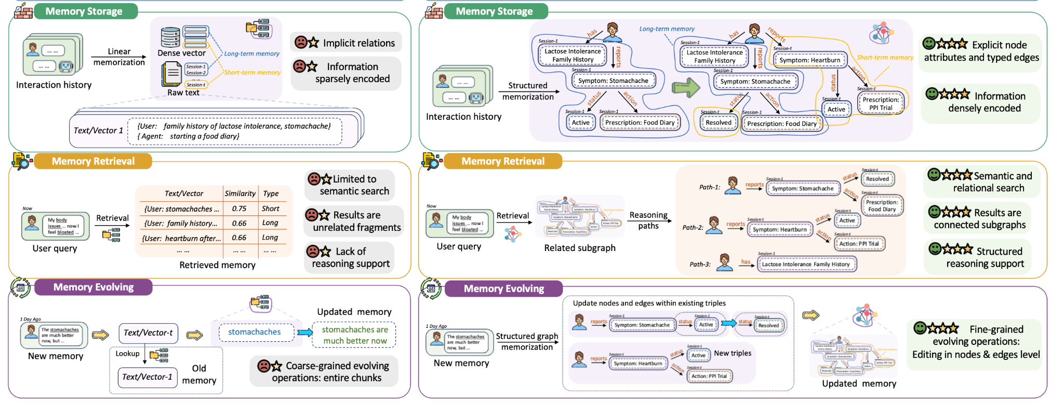
Stores past experience, what failure have we seen before

Slide 2
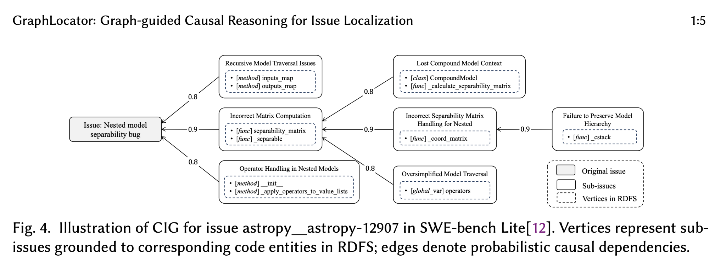
Casual-Reasoning graph
Stores past experience
Stores cause-and-effect, why did the failure happen?

Slide 3
Why?
Because currently, agents such as Repo2Run are “trial-and-error” where they fix local problems it encounters iterative until global completion. However, they miss that the system is an interdepedent success conditions
My approach introduces a graph-structured repair memory that separates factual observations
from planner-facing obligations. The graph records what the repository needs to run, which runtime blockers violate those needs, and which repair attempts have already targeted them.

Slide 4
ESSR-Success criteria
We need to change when the agent determines it should stop
Old: Agent must continue until 80% of the tests have been correctly executed. Many “partial” success not counted. I.e. a environment can be built to have 60% test pass, but not accepted, leading to low ESSR score

Slide 5
Most Docker Environment setup agent are reactive:
They run an action, and decide what to do based off what they observe (
Agent: “Missing numpy, install next
Pip install -e .
Repository Requirements
Agent
Module not found: Numpy

Slide 6
This reasoning format leads to agent stuck in a trial-and-error format, where they iteratively fix local bugs in the hope of finding global solution
But in fact, of environment setup procedurals and information is quiet deterministic, but rather needs mining + structured representation
Environment graph
Structured representation of what is needed to setup an environment. Guides agent on execution and debugging

Slide 7
flask 3.1.3
3
requires
requires
requires
werkzeug 3.1.8
click 8.3.2
blinker 1.9.0
2
Topological sort + SAT solving is used by package managers such as uv for automated installation, and version pinning
Resolved based off base image
jinja2 3.1.6
1

Slide 8
Python Project
We can use AST trees to identify the external packages the project imports:
Imports cv2
Cv2 -> opencv
Pip install opencv
flask 3.1.3
tqdm 4.66.3
requests 2.33.0
werkzeug 3.1.8
click 8.3.2
blinker 1.9.0
urllib3 2.6.3
certifi 2026.2.25
jinja2 3.1.6
Once we get the first order dependencies, we can give it to uv, which will automatically find the transitive dependencies and find compatible versions
schedule 1.2.1

Slide 9
However, such dependency graph is usually about, how do we successfully solve the dependency issues of a python program.
This is a subset of repository environment generation
Because only do we have to make the program resolve, we also have to build the environment to make it succeed
We also need to worry about: System Packages:
Runtime DB setup:
Environment Flags:

Slide 10
flask 3.1.3
3
requires
requires
requires
werkzeug 3.1.8
click 8.3.2
blinker 1.9.0
2
jinja2 3.1.6
libGL.so.1
1
libGL.so.1 is OS level graphics library required for packages like Open-CV to run

Slide 11
Python Project
Database
flask 3.1.3
tqdm 4.66.3
requests 2.33.0
Config
werkzeug 3.1.8
click 8.3.2
blinker 1.9.0
urllib3 2.6.3
certifi 2026.2.25
jinja2 3.1.6
schedule 1.2.1

Slide 12
Python Project
Pip install schedule 1.2.1
Pip install jinja2 3.1.6
Pip install click 8.3.2
……
Pytest run
flask 3.1.3
tqdm 4.66.3
requests 2.33.0
werkzeug 3.1.8
click 8.3.2
blinker 1.9.0
urllib3 2.6.3
certifi 2026.2.25
jinja2 3.1.6
schedule 1.2.1
Converts the graph topologically into a build script

Slide 13
Why use a build script:
Serves as an artifact for installation. Rather than trying different commands installs in the container. Easier to manage and debug
Allows an agent to have a “global” view of the installation process, rather than looking back in agent past history, which can get bloated.
Because we are editing one file, its is reproducible, making the final re-usable dockerfile generation easier

Slide 14
Pytest run
Pip install schedule 1.2.1 -> correct
Pip install jinja2 3.1.6 -> correct
Pip install click 8.3.2 -> incorrect
……
Pytest run
Agent:
Fix the build script
Error message
Build script patch

Slide 15
Method | ESSR (RAT) / Exec | ESSR / All | EBSR
RAT | 0.789 | 0.684 | 0.867
Repo2Run | 0.708 | 0.378 | 0.533

Slide 16
Method | Avg Token / Success | Avg Token / All | Total tokens used / 15 repo
RAT | 243k | 370k | 5.6 M
Repo2Run | 85k | 378k | 5.3 M

